Slide 1


FAT in AI: Fairness, Accountability, Transparency
Denis Parra, Assistant Professor
CS Department
School of Engineering
Pontificia Universidad Católica de Chile
Curso Exploratorio, Jueves 23 de Mayo de 2019

Slide 2
Millennium Institute
for
Foundational Research on Data (IMFD)

Slide 3

Millennium Initiative

Slide 4
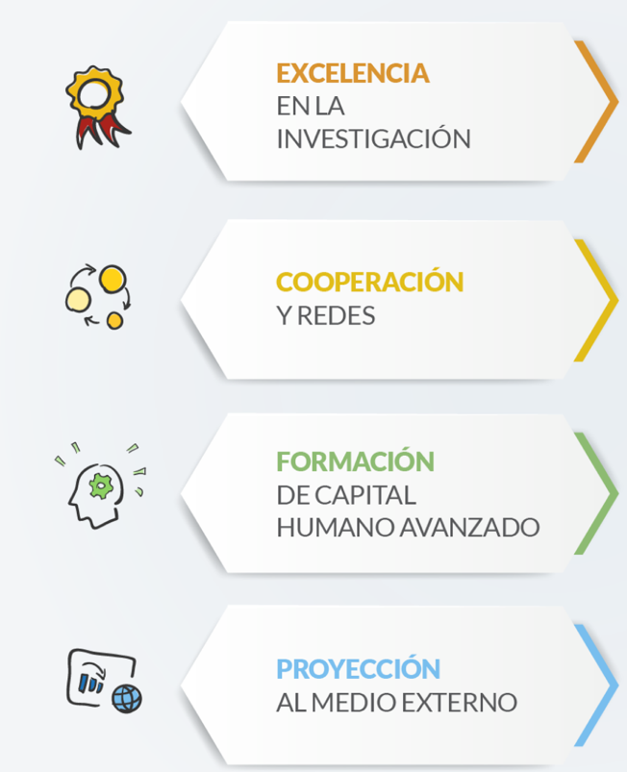
Millenium Initiative Goals
RESEARCH EXCELENCE
Improve quality and impact of Chilean research
COLLABORATION & NETWORKS
ADVANCED HUMAN CAPITAL
OUTREACH &
SOCIAL IMPACT

Slide 5
Millennium Initiative IMFD
Funding for 10 years (~1.3M euros per year)
Four main institutions:
PUC, UChile, USM, UdeC
15 associate researchers
+
15 young and adjunct researchers

Slide 6




















Foundations for a data-centric world
Access
Social impact
Policy
0101110110101010000111
Predict
Extract
Visualise
110110101010000111
Efficiency • Correctness • Security
10101010000111
Acquire
1010000111
000111
Search
Rank
Query
Model
Integrate
Notes:
Generating
Large Hadron Collider
Analyse
Consequences in the design of policies

Slide 7
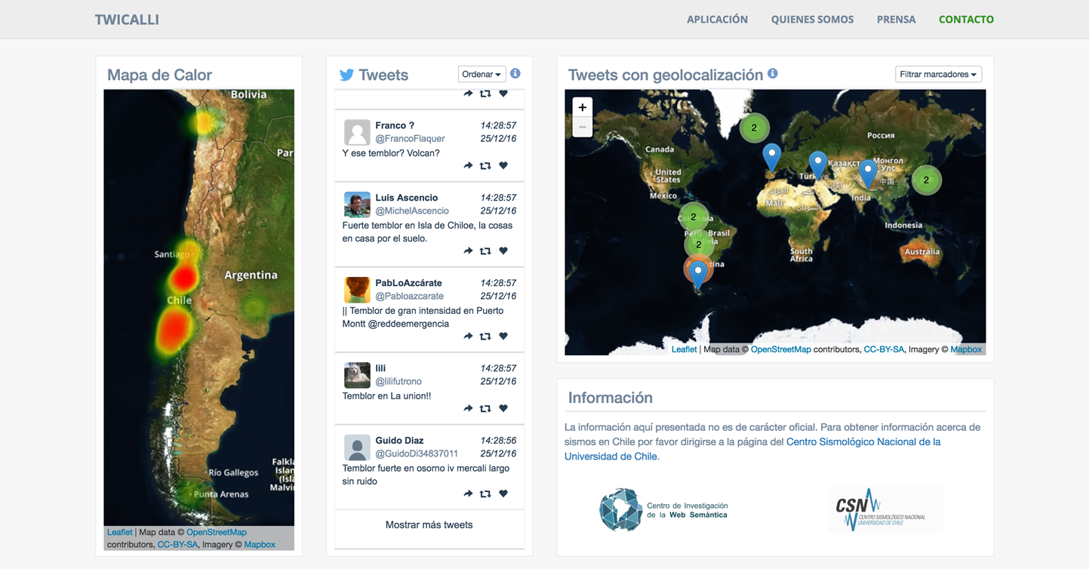
Monitoring earthquake reaction
System detects earthquakes based on Tweets
Same scientific and technological challenges as in the Chilean constitutional process
Social impact: used in the National Seismological Centre

Slide 8
Data as an object of study
Access
Social impact
Policy
0101110110101010000111
Predict
Extract
Visualise
110110101010000111
Efficiency • Correctness • Security
10101010000111
Acquire
1010000111
000111
Search
Rank
Query
Model
Integrate

Slide 9
Data as an object of study
Semantic Web
Data Management
Access
Social impact
Policy
0101110110101010000111
Predict
Extract
Visualise
110110101010000111
Efficiency • Correctness • Security
10101010000111
Acquire
1010000111
000111
Search
Rank
Query
Model
Integrate

Slide 10
Data as an object of study
Semantic Web
Data Management
Algorithms & Data Structures
Access
Social impact
Policy
0101110110101010000111
Predict
Extract
Visualise
110110101010000111
Efficiency • Correctness • Security
10101010000111
Acquire
1010000111
000111
Search
Rank
Query
Model
Integrate

Slide 11
Data as an object of study
Semantic Web
Data Management
Algorithms & Data Structures
Program Verification
Access
Social impact
Policy
0101110110101010000111
Predict
Extract
Visualise
110110101010000111
Efficiency • Correctness • Security
10101010000111
Acquire
1010000111
000111
Search
Rank
Query
Model
Integrate

Slide 12
Data as an object of study
Semantic Web
Data Management
Algorithms & Data Structures
Program Verification
Access
Social impact
Policy
Privacy & Security
0101110110101010000111
Predict
Extract
Visualise
110110101010000111
Efficiency • Correctness • Security
10101010000111
Acquire
1010000111
000111
Search
Rank
Query
Model
Integrate

Slide 13
Data as an object of study
Semantic Web
Data Management
Algorithms & Data Structures
Program Verification
Access
Social impact
Policy
Privacy & Security
Information Retrieval
0101110110101010000111
Predict
Extract
Visualise
110110101010000111
Efficiency • Correctness • Security
10101010000111
Acquire
1010000111
000111
Search
Rank
Query
Model
Integrate

Slide 14
Data as an object of study
Semantic Web
Data Management
Algorithms & Data Structures
Program Verification
Access
Social impact
Policy
Privacy & Security
Information Retrieval
Statistics & Machine Learning
0101110110101010000111
Predict
Extract
Visualise
110110101010000111
Efficiency • Correctness • Security
10101010000111
Acquire
1010000111
000111
Search
Rank
Query
Model
Integrate

Slide 15
Data as an object of study
Semantic Web
Data Management
Algorithms & Data Structures
Program Verification
Access
Social impact
Policy
Privacy & Security
Information Retrieval
Statistics & Machine Learning
0101110110101010000111
Predict
Extract
Visualise
110110101010000111
Efficiency • Correctness • Security
Data Mining
10101010000111
Acquire
1010000111
000111
Search
Rank
Query
Model
Integrate

Slide 16
Data as an object of study
Semantic Web
Data Management
Algorithms & Data Structures
Program Verification
Access
Social impact
Policy
Privacy & Security
Information Retrieval
Statistics & Machine Learning
0101110110101010000111
Predict
Extract
Visualise
110110101010000111
Efficiency • Correctness • Security
Data Mining
10101010000111
Acquire
1010000111
Visualisation
000111
Search
Rank
Query
Model
Integrate

Slide 17
Data as an object of study
Networks
Social Science
Semantic Web
Data Management
Algorithms & Data Structures
Program Verification
Access
Social impact
Policy
Privacy & Security
Information Retrieval
Statistics & Machine Learning
0101110110101010000111
Predict
Extract
Visualise
110110101010000111
Efficiency • Correctness • Security
Data Mining
10101010000111
Acquire
1010000111
Visualisation
000111
Search
Rank
Query
Model
Integrate

Slide 18
Data as an object of study
Semantic Web
Data Management
Algorithms & Data Structures
Program Verification
Access
Social impact
Policy
Privacy & Security
Information Retrieval
Statistics & Machine Learning
0101110110101010000111
Predict
Extract
Visualise
110110101010000111
Efficiency • Correctness • Security
Data Mining
10101010000111
Acquire
1010000111
Visualisation
000111
Networks
Search
Rank
Query
Social Science
Model
Integrate

Slide 19
Our ten-year vision
Advance:
Mathematical principles for different aspects of data
Systems to better manage and analyse real-world data
Form:
A critical mass of researchers and engineers focussed on data
Develop:
An infrastructure to better exploit public data
Chile will have a world-class Data Research centre, leading such efforts in Latin America

Slide 20
Emblematic Projects
Getting closer to isolated neighborhoods in Santiago as well as in Araucanía (Mapuche natives)
Development of a standard query language for graphs.
Query languages with structural and analytical capacities.
Development of explainable artificial intelligence.
Robust information structures: filter bubbles, information wars, communication in disasters.

Slide 21
Emblematic Projects
Getting closer to isolated neighborhoods in Santiago as well as in Araucanía (Mapuche natives)
Development of a standard query language for graphs.
Query languages with structural and analytical capacities.
Development of explainable artificial intelligence.
Robust information structures: filter bubbles, information wars, communication in disasters.

Slide 22
We are living incredible days…
Technology is showing results which resemble science fiction…

Slide 23
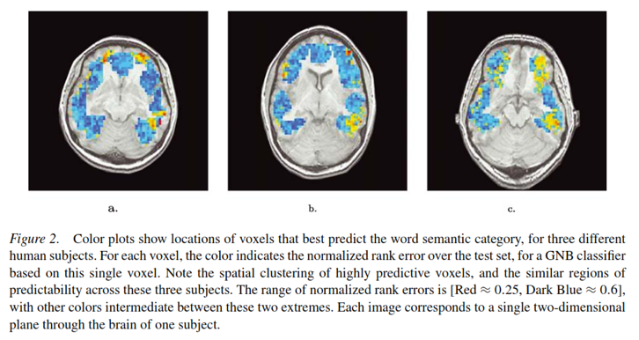
Recognizing mental state from fMRI

Slide 24
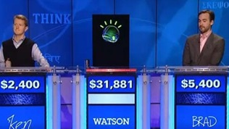
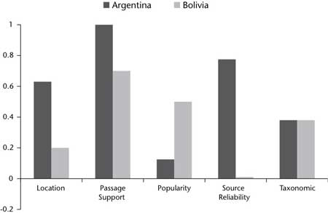
Natural Language Processing
IBM Watson beats humans in Jeopardy. << ... With all of its processing CPU power, Watson can scan two million pages of data in three seconds.>> E. Nyberg, CMU professor
Implications: Applications in Health domain.
Chile shares its largest frontier with this country …
http://www.aaai.org/Magazine/Watson/watson.php

Slide 25
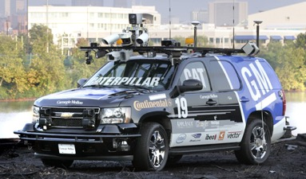
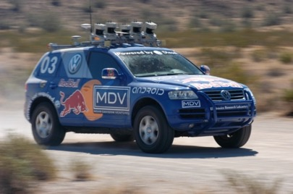
Self-Driving Cars

Slide 26
Music Generation with Style
Deep learning driven jazz generation
https://github.com/jisungk/deepjazz
https://soundcloud.com/deepjazz-ai

Slide 27
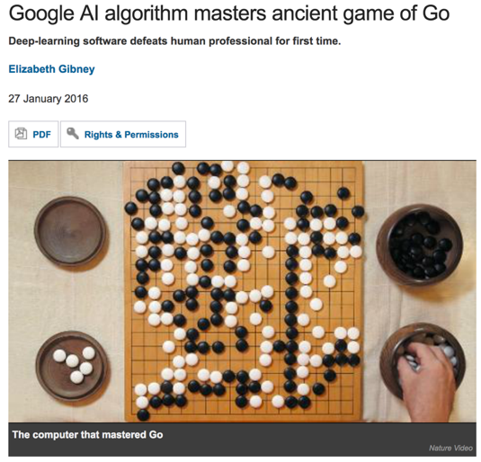
Mastering Go

Slide 28
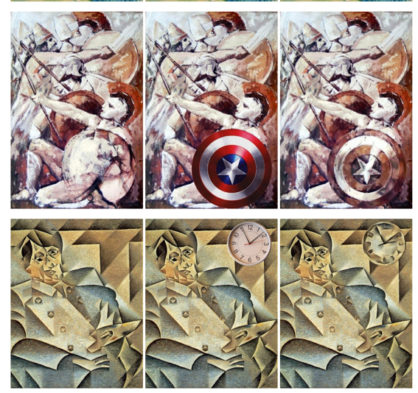
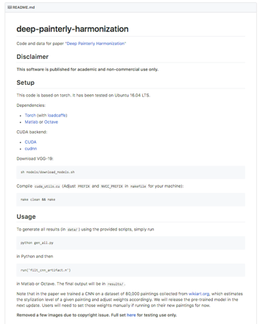
AI for incorporating style in images
https://github.com/luanfujun/deep-painterly-harmonization

Slide 29
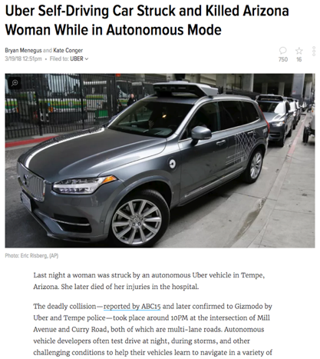
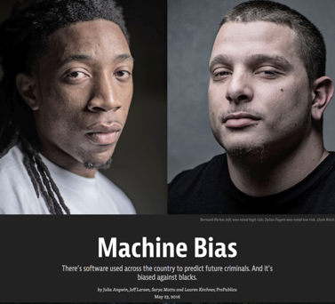
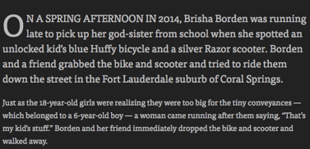
But there are some problems

Slide 30
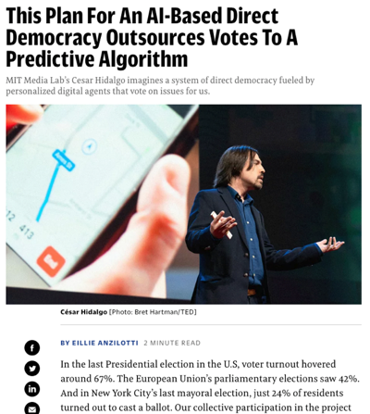
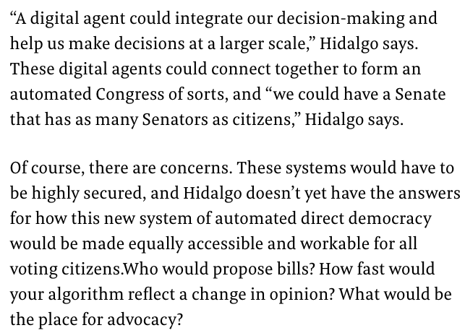
AI for automatic decision making…
https://www.fastcompany.com/40557688/this-plan-for-an-ai-based-direct-democracy-outsources-votes-to-a-predictive-algorithm

Slide 31
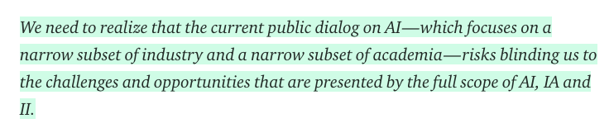
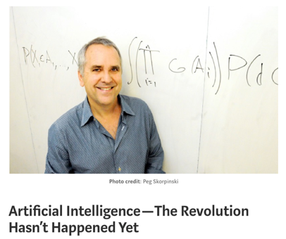
Some voices call for calm…
Thus, just as humans built buildings and bridges before there was civil engineering, humans are proceeding with the building of societal-scale, inference-and-decision-making systems that involve machines, humans and the environment.
Just as early buildings and bridges sometimes fell to the ground — in unforeseen ways and with tragic consequences — many of our early societal-scale inference-and-decision-making systems are already exposing serious conceptual flaws.
https://medium.com/@mijordan3/artificial-intelligence-the-revolution-hasnt-happened-yet-5e1d5812e1e7

Slide 32
Part II
What happened in May 25th 2018
Which role can take Information Visualization and Interaction in AI ?

Slide 33
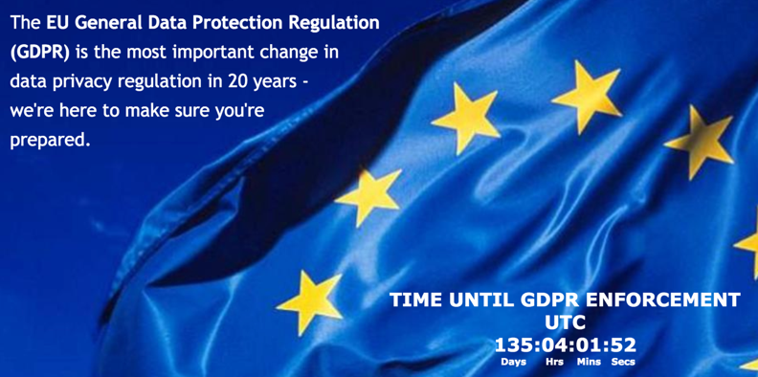
So, What happened in May 25th, 2018 ?
The EU General Data Protection Regulation (GDPR) becomes enforceable.

Slide 34
And why do we care in this room ?
The GDPR not only applies to organisations located within the EU but it will also apply to organisations located outside of the EU if they offer goods or services to, or monitor the behaviour of, EU data subjects.
It applies to all companies processing and holding the personal data of data subjects residing in the European Union, regardless of the company’s location.

Slide 35
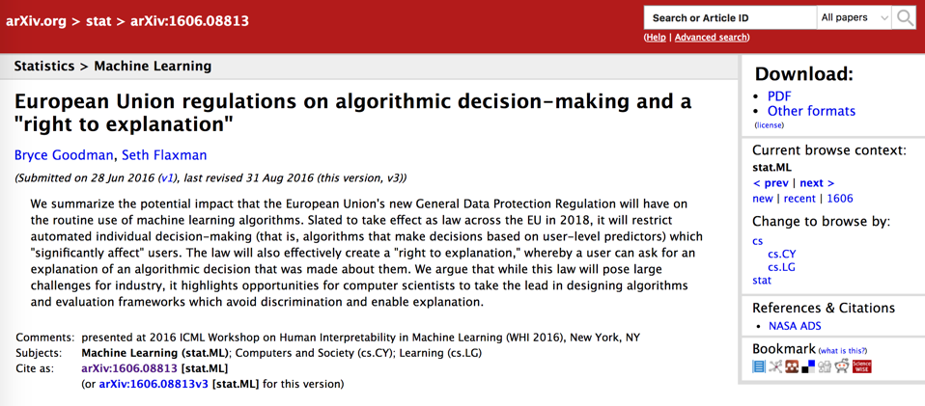
Human Interpretability in ML
https://arxiv.org/abs/1606.08813

Slide 36
Which is the effect on my current practice ?
Right to explanation
Article 15 “Right of access by the data subject”
Article 22 “Automated individual decision-making, including profiling”
Recital 71 (linked to art. 22)

Slide 37
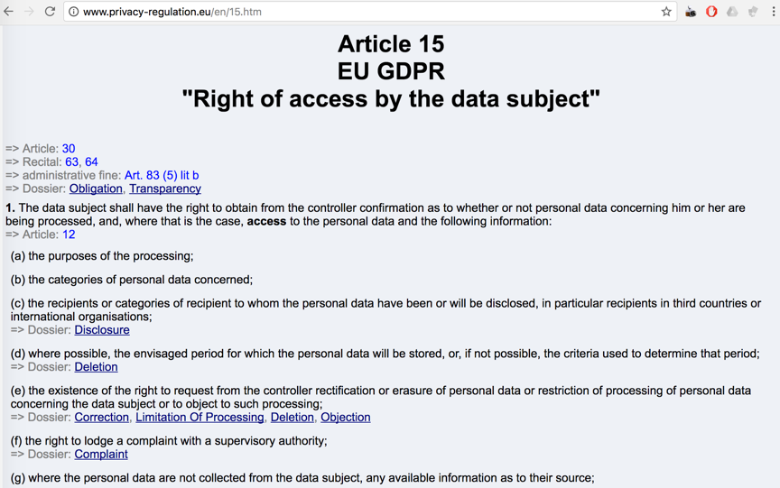
Article 15

Slide 38
Article 15
<<The data subject shall have the right to obtain … access to the personal data … [information of] the existence of automated decision-making, including profiling, referred to in Article 22(1) and (4) and, at least in those cases, meaningful information about the logic involved … >>

Slide 39
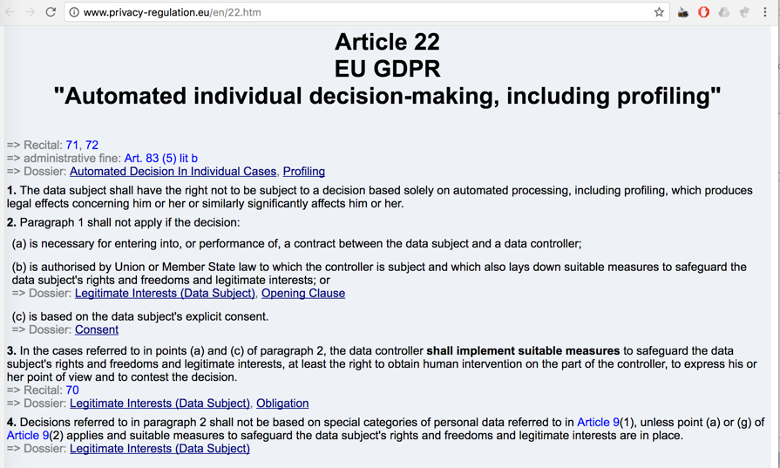
Article 22

Slide 40
Article 22
I
<<The data subject shall have the right not to be subject to a decision based solely on automated processing, including profiling, which produces legal effects concerning him or her or similarly significantly affects him or her.… >>

Slide 41
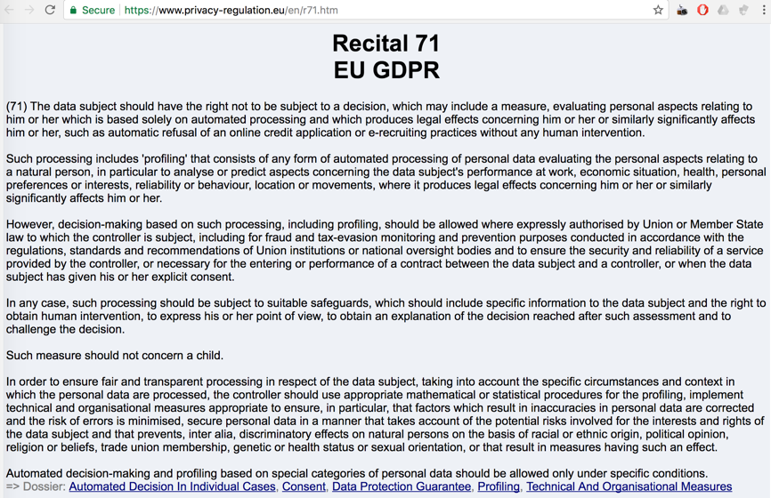
Recital 71

Slide 42
Recital 71
In order to ensure fair and transparent processing in respect of the data subject, taking into account the specific circumstances and context in which the personal data are processed, the controller should use appropriate mathematical or statistical procedures for the profiling …

Slide 43
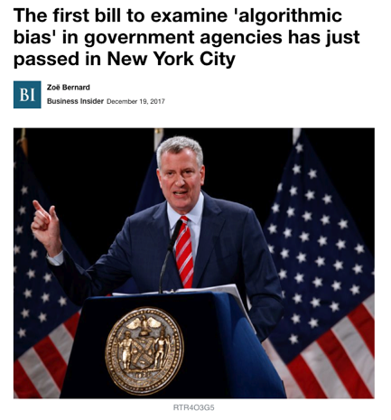
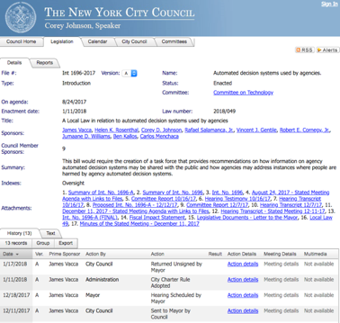
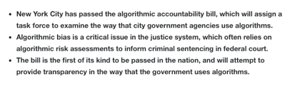
Other Initiatives (2018)
This bill would require the creation of a task force that provides recommendations on how information on agency automated decision systems may be shared with the public and how agencies may address instances where people are harmed by agency automated decision systems.

Slide 44
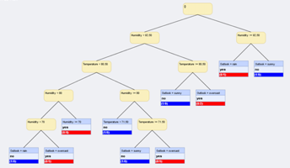
ML and GDPR
How do we explain Machine Learning models?
From Decision Trees to Deep Neural Networks
Explainable decision model, explicit variables, not very accurate
Black-box decision model,
latent variables, accurate

Slide 45
Challenges
Are there methods to explain models?
Can we create methods to help us explain decisions made by complex models such as DNN ?
Can visualization & interaction help in this issue?

Slide 46
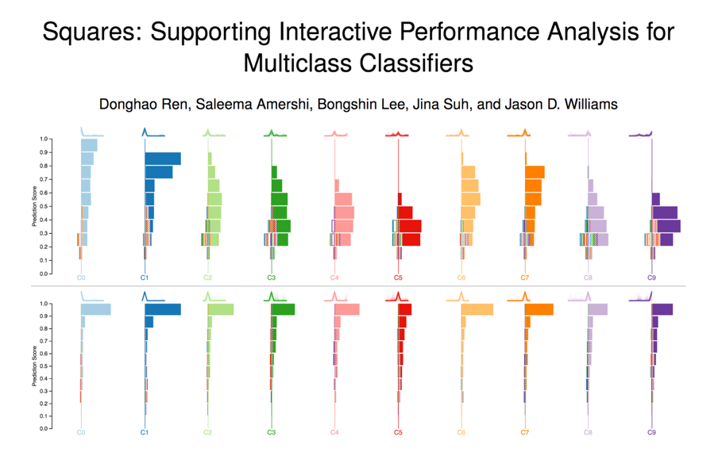
IEEE Vis 2016

Slide 47
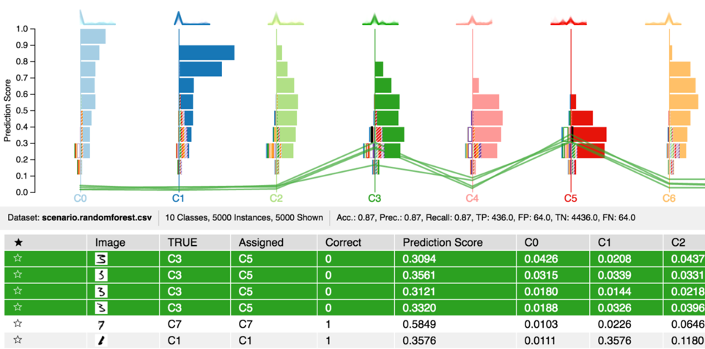
Detail

Slide 48
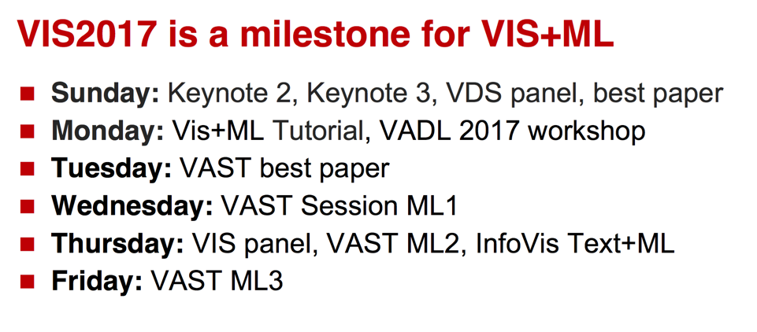
IEEE VIS 2017

Slide 49
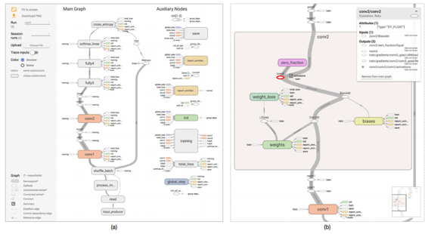
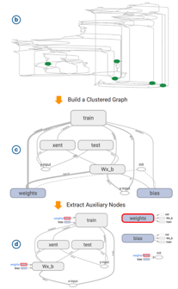
IEEE 2017 VAST Best Paper
Visualizing Dataflow Graphs of Deep Learning Models in TensorFlow Authors: Kanit Wongsuphasawat, Daniel Smilkov, James Wexler, Jimbo Wilson, Dandelion Mané, Doug Fritz, Dilip Krishnan, Fernanda B. Viégas, and Martin Wattenberg

Slide 50
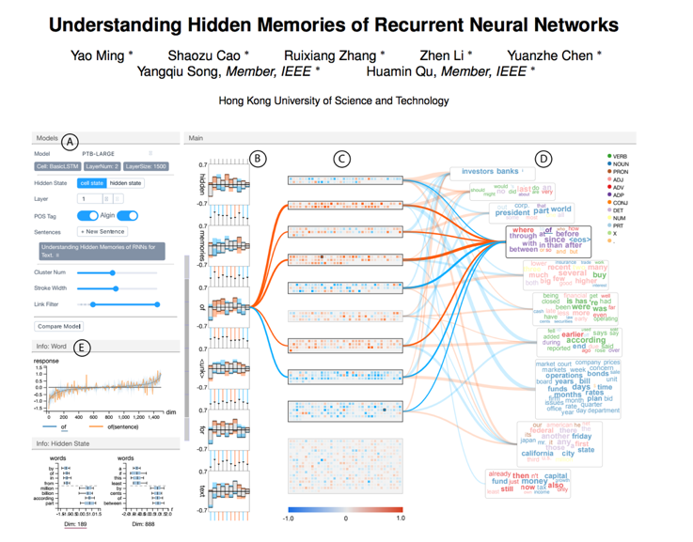
How do RNNs work?

Slide 51
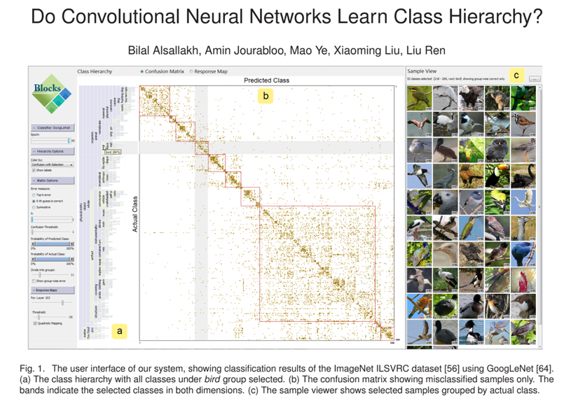
Do CNNs learn hierarchies ?

Slide 52

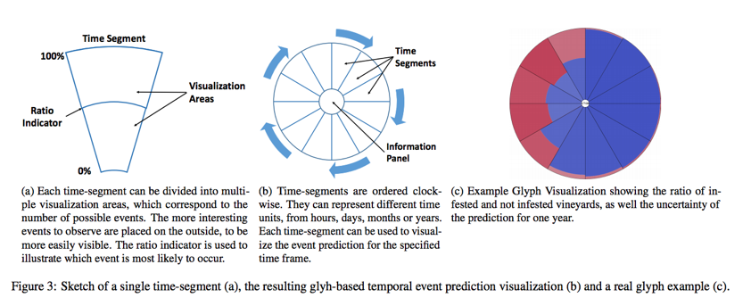
Symposium: Visual Data Science + ML

Slide 53
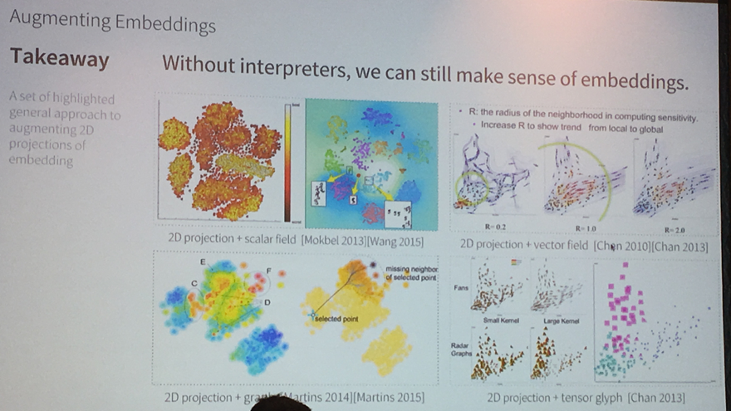
UBER Visualization and Machine Learning

Slide 54
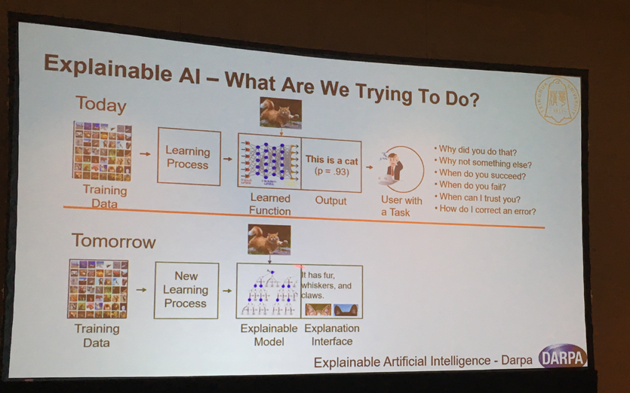
Workshop on Explainable ML

Slide 55
Workshop on Explainable ML
DARPA is funding
Explainable AI

Slide 56
New Journals & Conferences
Distill.pub
FAT conference

Slide 57
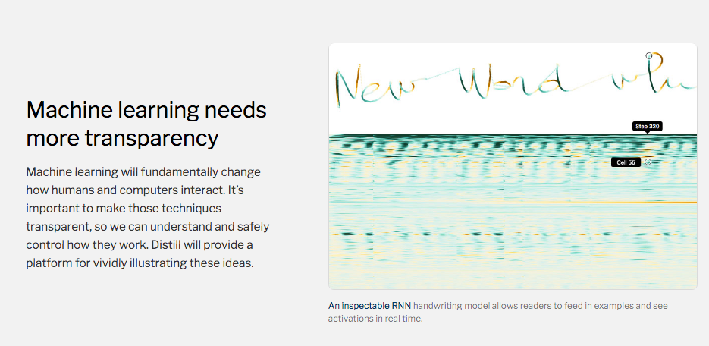
Distill.pub

Slide 58
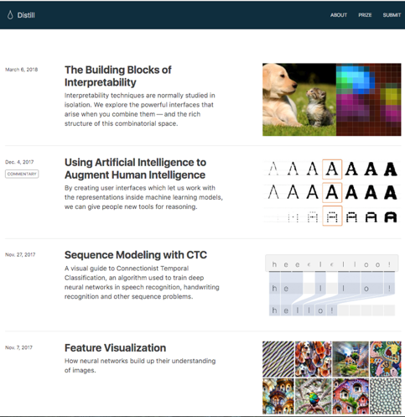
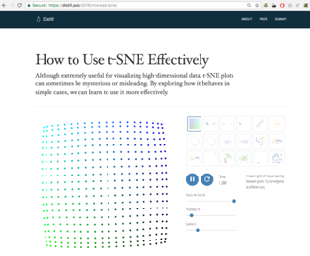
Distill.pub
Ejemplo: t-SNE
https://distill.pub/2016/misread-tsne/

Slide 59

https://fatconference.org/
The FAT* Conference 2018 is a two-day event that brings together researchers and practitioners interested in fairness, accountability, and transparency in socio-technical systems.

Slide 60
Research Opportunities
New Millenium Institute for Foundational Research on Data (IMFD)
Lidera Profesor Marcelo Arenas, DCC PUC Chile
Investigadores de PUC, UChile, USM, UdeC
Áreas: Computación, Estadística, Matemáticas, Sociología, Ciencia Política, Comunicaciones (Periodismo)

Slide 61
References
Goodman, B., & Flaxman, S. (2016). EU regulations on algorithmic decision-making and a “right to explanation”. In ICML workshop on human interpretability in machine learning (WHI 2016), New York, NY. http://arxiv. org/abs/1606.08813 v1.
Edwards, L., & Veale, M. (2017). Slave to the Algorithm? Why a ‘Right to Explanation’ is Probably Not the Remedy You are Looking for. Duke Law & Technology Review.

Slide 62

Thanks!
dparra@ing.puc.cl

